Slide 1

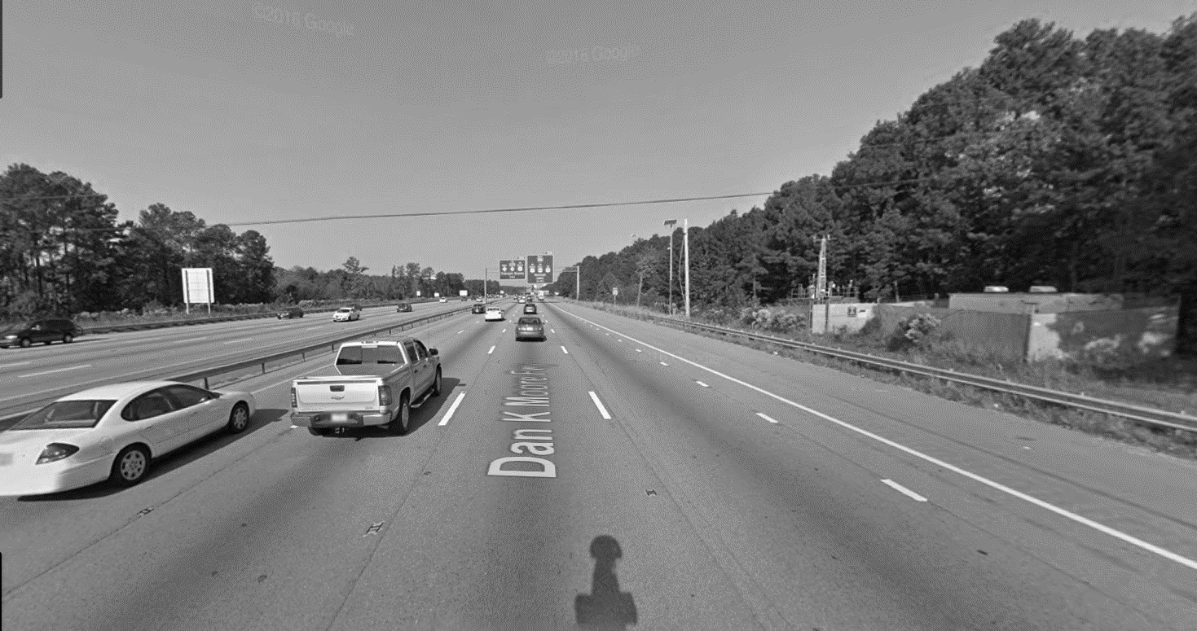
On the link between traffic-based indices and near-road air quality
Kwanpyo Ko
Traffic
Statistical Model
Air Quality
Data
HV Index
Low speed indicator
Meteorological Var.
- Wind (Dir., Spd.)
- Temperature
Near-road site
Background site monitoring
- NOx
- Black carbon
- Ultrafine particles
Freeway Site
Microwave sensors
- Counts
- Heavy vehicle counts
- Speed
Index
Volume Index
HV Index
Density Index
RTMS
Air quality monitoring station

